Slide 1
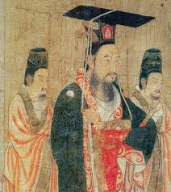
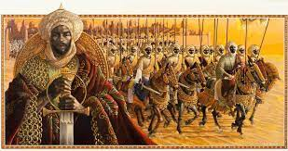
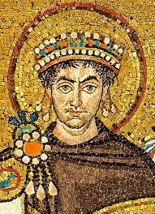
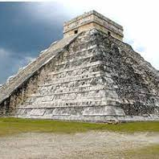
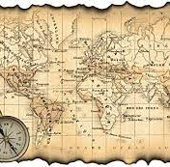
10^{th-}Grade World History
Mrs. Hacker 2022-23

Slide 2
10th Grade World History
Mrs. Hacker 2022-23
Course Description:
World History engages students in the study of the geography, history, civics, and economy of a variety of cultures throughout the world, often through a project-based format. The course begins in 1450 and traces the history of the world to the present, exposing students to a global perspective of the world. Students will study the development and interaction of cultures, the interactions between humans and the environment, and the creation, expansion, and interaction of economic, political, and social systems. Special attention will be given to informational reading and analytical writing skills throughout the year, focusing on skills such as recognizing point of view, detecting bias, developing a global chronology, and periodization.

Slide 3
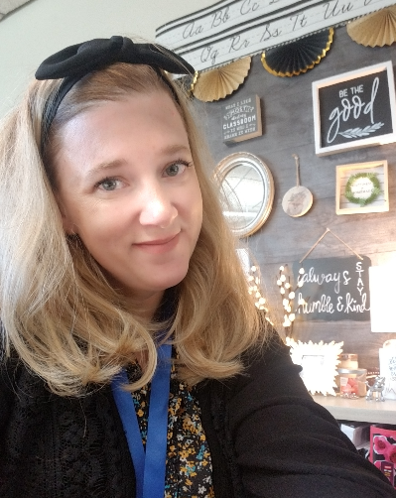
Welcome Pirates to the 2022-2023 school year. I am very excited to return to the classroom for my 24th year in education. I will be your Social Studies Teacher for 10^{th-}grade World History.
This will be my first year at Rogers High School. I look forward to teaching and engaging lessons that inspire students’ love for learning while achieving individual learning goals and targets for the 10^{th-}grade.

Slide 4
Outside of teaching, I enjoy hiking on Mt. Rainier with my family, writing short stories, drawing, painting, and singing. I am looking forward to an amazing year of learning! I want to get to know each of you this year and discover what makes you a unique individual. In turn, I hope you will enjoy learning about History. Together, we will develop a positive learning environment where you can explore new ideas, practice skills to develop expertise, and feel comfortable and safe in expressing yourself.

Slide 5
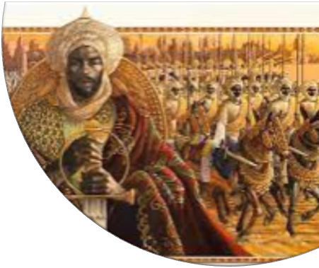
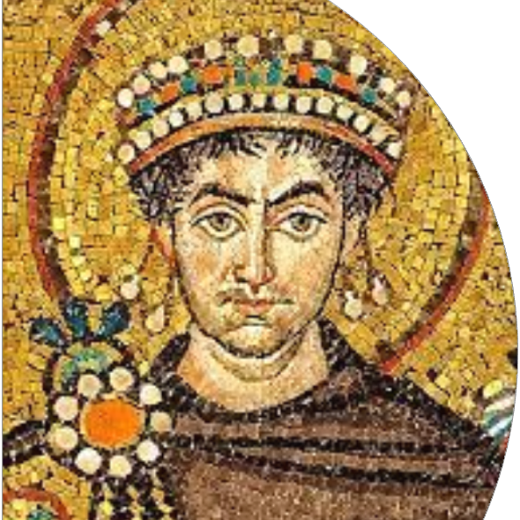
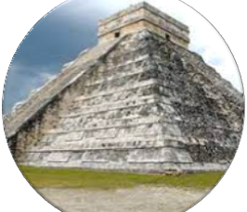
10^{th-}Grade
World History
Mrs. Hacker 2022-23
In World History, we will learn to think, read, and communicate like historians so that, by the end of the year, you will be able to say: I can…
Make sense of the past and the present. (What really happened? Why? How can I know for sure?)
Make and effectively communicate thoughtful evaluations and conclusions about historical events (What do I think? Why? What supports my conclusion? How can I best communicate that to others?)
Throughout the year, we will develop key skills, learn to use historical context and study four key time periods to assist us in our ability to think, read and communicate like a historian.

Slide 6
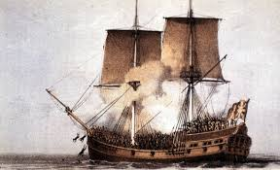
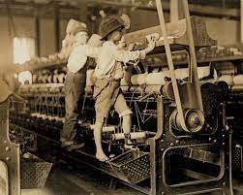
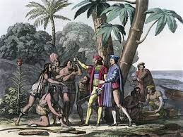
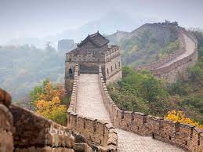
10^{th-}Grade
World History
Mrs. Hacker 2022-23
Skills: Critical reading, asking questions, applying historical contexts, identifying cause and effect, describing continuity and change, evaluating the reliability of sources, finding and using evidence, communicating conclusions and thinking through writing and presentations.
Historical Context:
Cultural Interactions
Political Structures
Economic Structures
Social Structures
Human-Environmental interactions
Time Periods:
Global Encounters: 1450-1770
Age of Revolution: 1750-1920
Global Crisis: 1870-1945
Global Conflicts: 1945-present
:

Slide 7
10^{th-}Grade World History
Mrs. Hacker 2022-23
Quarter Assessments:
Quarter One: Middle Passage, Read Like a Historian.
Quarter Two: Factory Life, Read Like a Historian.
Quarter Three: Battle of Somme, Read like a Historian.
Quarter Four: Current Global Issues, Research Project and presentation.

Slide 8
Communication and Student Support
Microsoft TEAMS- I will update our World History Team daily with assignments, power-points, and additional resource materials to help support learning. Students can use the Daily Agenda Channel on our TEAMS page to keep up- to-date.
Remind APP- I will send important reminders to students and families for homework and projects. In addition, if there are changes in the calendar/schedule.
Teacher Planning Period- I am available during 1st and 2nd lunch in my classroom to help support students. Students are welcome to bring their lunch and work on assignments with teacher support and guidance.
10th Grade World History
Communication and Support

Slide 9
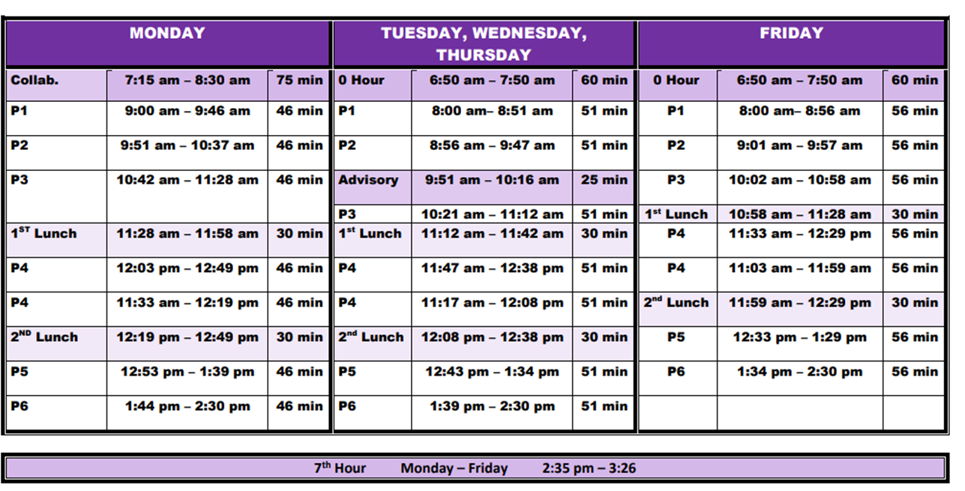
Rogers Bell Schedule 2022-23

Slide 10
Mrs. Hacker’s Schedule 2022-23
Room 120N
Email: CheriH@spokaneschools.org
1st Period: 10th-Grade World History
2nd Period: 10^{th-}Grade World History
Advisory: 11^{th-}Grade
3rd Period: 10^{th-}Grade World History
4th Period: Teacher Planning Period
5th Period: 11^{th-}Grade English
6th Period: 11^{th-}Grade English

Slide 11
Mrs. Hacker’s Contact Information:
CheriH@spokaneschools.org
509-354-6600

